Slide 1

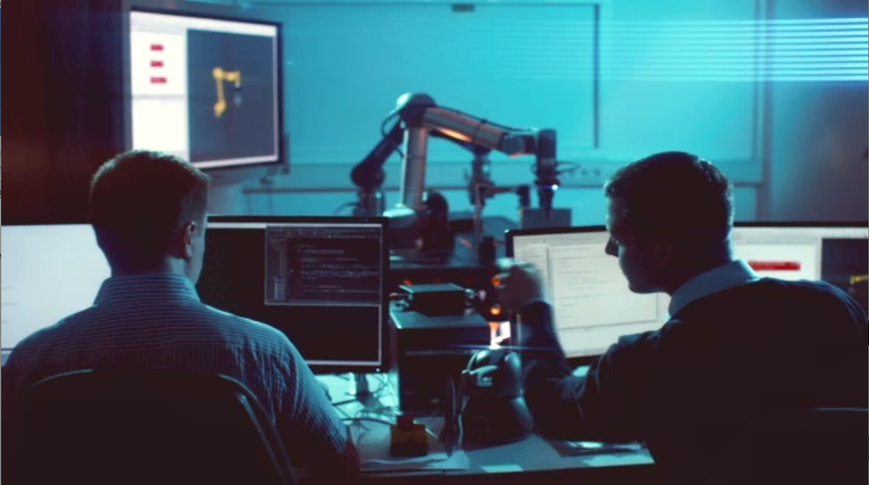
Confidential Information
For EU Commission administration only
DexBuddy commercial impact

Slide 2

I.
Current growth of ArtiMinds

Slide 3
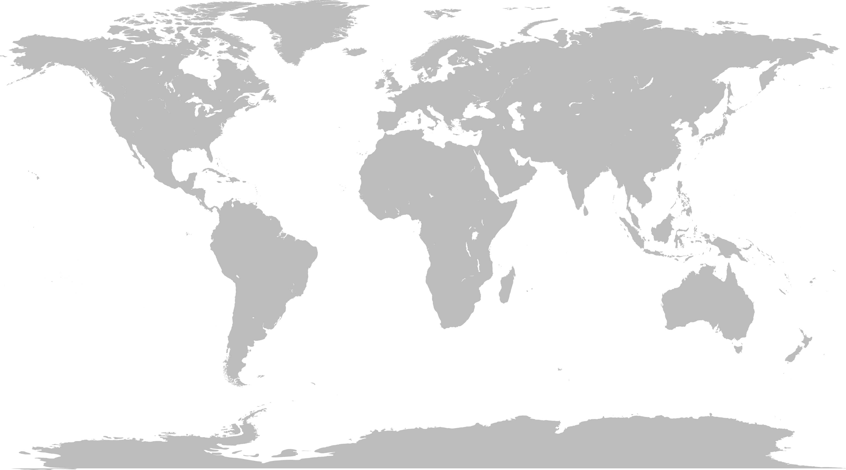
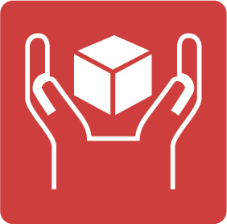








2002-2013
2013
2014
2016
2018

Slide 4
Applications tackled by ArtiMinds’ paying customers with ArtiMinds software:
(Electric) cars, electric trains, trucks, airplanes
PCs, computer parts, consumer & industrial electronics, components, LEDs
Mechanical industrial components: gears, sealing, valves, fans, casings etc.
Washing & coffee machines, dishwashers, vacuum cleaners, sanitary installations
Clean tech: wind turbines, solar electronics
Clothes
Chairs
Packaging for pharma, boxes for stores
Dental tech, pharma chemistry
Food handling

Slide 5

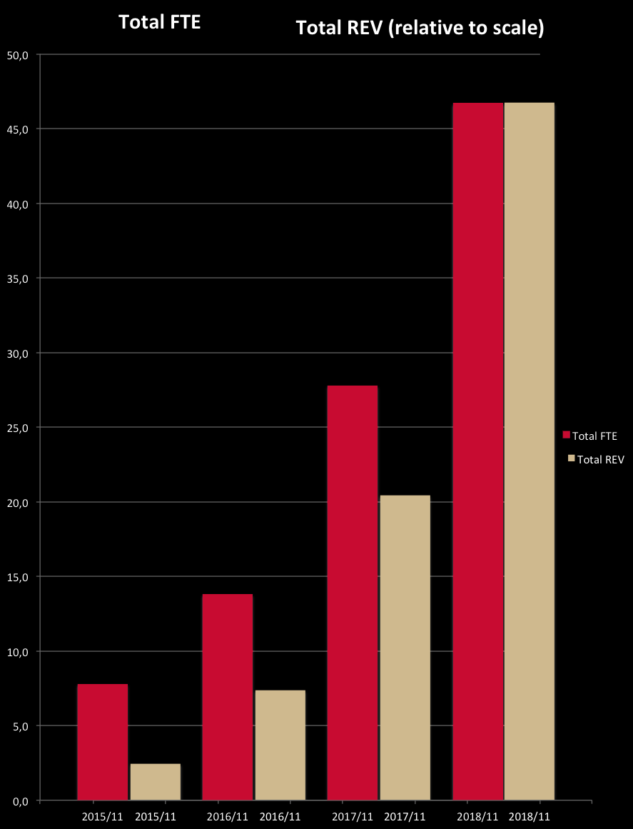
REV relative to FTE
2015
2018
FTE
Revenue
6x
20x
Fast team growth
(FTE = full time equivalents)
Much faster revenue growth
No relevant “burn rate” anymore

Slide 6
II.
Applications derived from DexBuddy insights

Slide 7
Commercial progress:
Several confidential applications were developed as follow-up of DexBuddy in the space of assembly of flexible materials:
The Siemens Train Systems cable assembly applications, of which a mock-up video had already been delivered, was further developed up to full prototype solution, used in some short production runs. Currently, a pilot series robot cell is built to be used in longer production runs. The cell is used for lot-size-1 assembly of cable harness plugs for electric freight locomotives in direct collaboration with human workers. It helps the competitiveness of European train manufacturing against quickly advancing Chinese competition.
The next commercial project is a cable harness assembly applications for a major Automotive supplier. Here, more large-scale application scenarios of higher lot sizes, but also even higher cable harness complexity are realized with a combination of 3D-vision and force-sensing, thus resembling the DexBuddy approach even more than the Train Systems example. A fully production-ready pilot cell has now been realized and is being tested in real production. Roll-out to several factories on several continents is planned. The solution can increase competitiveness of specific Eastern European factories against Asian factories.
A relatively new commercial project of even higher technical complexity deals with the assembly of 2D-flexible leather parts in automotive for a major European automotive supplier using machine vision and force sensing. The finished solution will vastly increase competitiveness of mainly existing Spanish and French factories against Asian competition.
All progress of these highly innovative commercial applications with machine vision and/or force-torque-sensing for human-like robotic assembly operations is covered by strict confidentiality agreements (except the early part of the Siemens application). Thus, no videos can be shown here. DexBuddy reviewers can answer some questions concerning that progress.
Concerning Page 21 of the original DexBuddy Review slides (29072016 - Review - Results.pptx), the two points “3D vision” (for cable manipulation) and “motion planning with vision for cable manipulation” were continued towards TRL 7/8, with TRL 9 likely to be reached soon, preserving European factories and thus jobs.
High-dof end-effectors, on the other hand, were not followed on further, because they currently add no value in the commercial applications.
We have prepared a dedicated show case for the DexBuddy impact investigation mimicking these commercial applications. See next slide.

Slide 8


