Slide 1
Laser Assisted RObotic Surgery of the anterior Eye Segment
D 6.1 First release of integrated robotic platform
Authors:
Bernardo Magnani; Ekymed Srl
Fabio Leoni; Fastenica Srl
Francesca Rossi; IFAC-CNR
Filippo Micheletti ; IFAC-CNR

Slide 2
Outline of the presentation
Introduction:
  project objectives & overall description
  physical constraints
  system architecture
Current status of implemented modules:
  handpiece / end-effector
  Laser control system and robot control
  tests & results at 25/07/2016

Slide 3
Objective of the project
to develop a “proof of concept” of a robotic platform for laser eye surgery, cornea transplantation
the aim of LA-ROSES project is to:
  implement a robotic platform for assisting eye surgical operations. The robotic platform consists of a 6 degrees of freedom robotic arm system and a mounted vision system allowing the robotic arm to be driven using a visual servoing approach
  implement a revised end-effector (partially developed in MILORDS project) sensorized with force feedback and distance and able to accommodate the applicator handpiece to fix the distance of the fiber tip of the diode laser
increase the precision of the laser-induced suture of the cornea from 1-2 mm (laser manually handled) to 0,01 mm

Slide 4
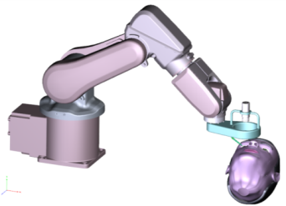
LA-ROSES System
It consists of three main systems and other sub-systems, as follows:
  6 DOF robotics arm
  vision system (NIR camera and thermal camera)
  laser module
  laser orienting and translating mechanisms
  visual interface and the visual servoing control system
  a preliminary sketch of the overall system is shown in the following picture

Slide 5
Functional requirements
enabling circular movement of a laser module allowing a tracking of the circular path marked by the indocyanine solution
in order to ensure a perfect tissue welding result an accurate temperature control induced by the photothermal effect caused by the laser irradiation is required
enabling detection of the wound site with automatic tracking and handling of the laser spot
enabling changing laser orientation, altitude from the corneal external surface at the wound site, and tracking velocity during the welding procedure
enabling initial gross and accurate positioning of the laser probe above the patient’s eye
accurate laser probe positioning above the patient’s eye

Slide 6
Anatomical constraints
Nose and supraorbital ridge interferences

Slide 7
End-effector functional scheme

Slide 8
End-effector status
no force feedback implemented: with the new laser, there is no need to touch the cornea surface
the use of a laser distance system eliminates also the sterilisation issues
it is anyway necessary to know the distance (camera-cornea), but this can be done directly with a calibration of the camera and the kinematics of the system
the end-effector was designed for a large set of configurations:
  Laser working distance from 10 cm to 40 cm
  Laser angle from 20° to 70°
the measured resolution of the motors is below 0,1 μm

Slide 9
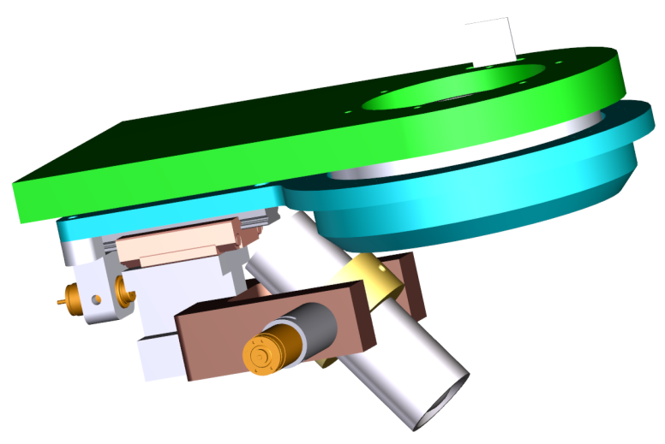
End-effector design 1st version
“z-axis” motor
(internal not visible)
“α-axis” motor
“x-axis” motor

Slide 10
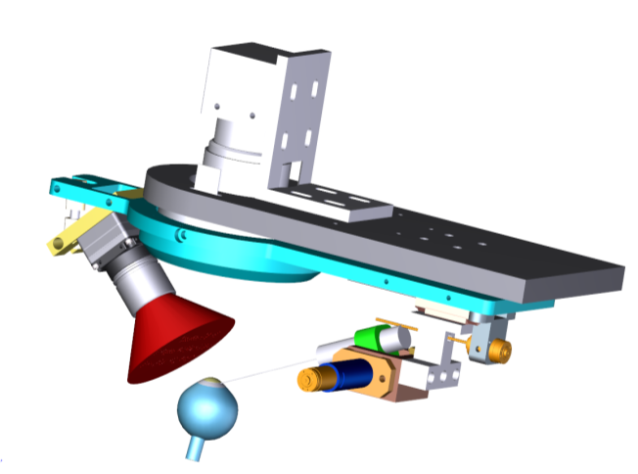
End-effector design 2nd version
“z-axis” motor
(internal not visible)
“x-axis” motor
“α-axis” motor

Slide 11
End-effector design last version
“z-axis” motor
(internal not visible)
“α-axis” motor
“x-axis” motor

Slide 12
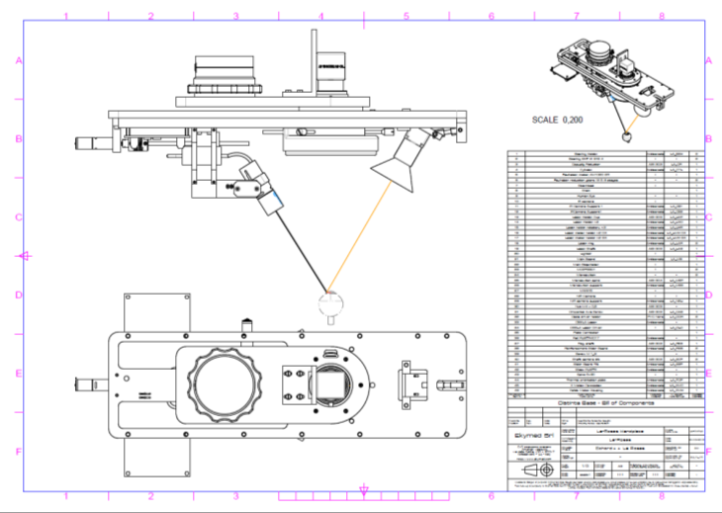
End-effector design

Slide 13
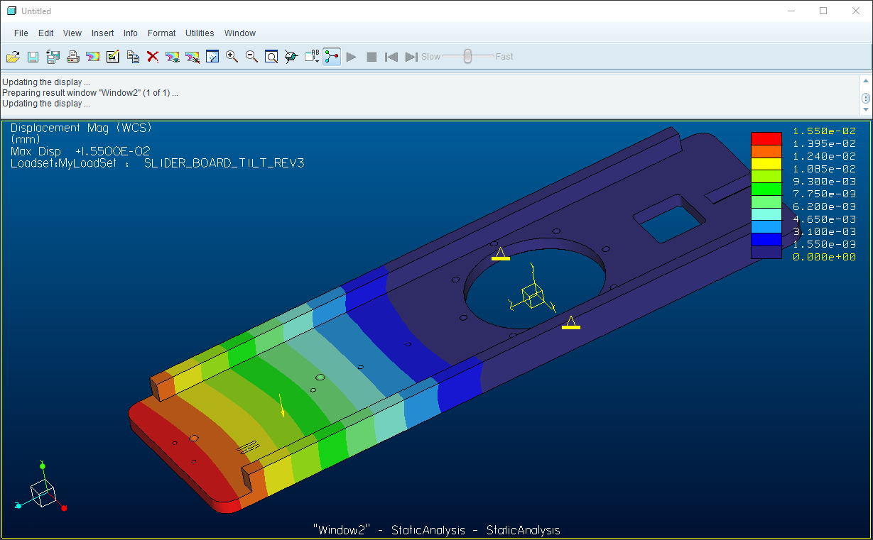
Main plate bending simulation
Max bending z value : 1,55 E-2

Slide 14
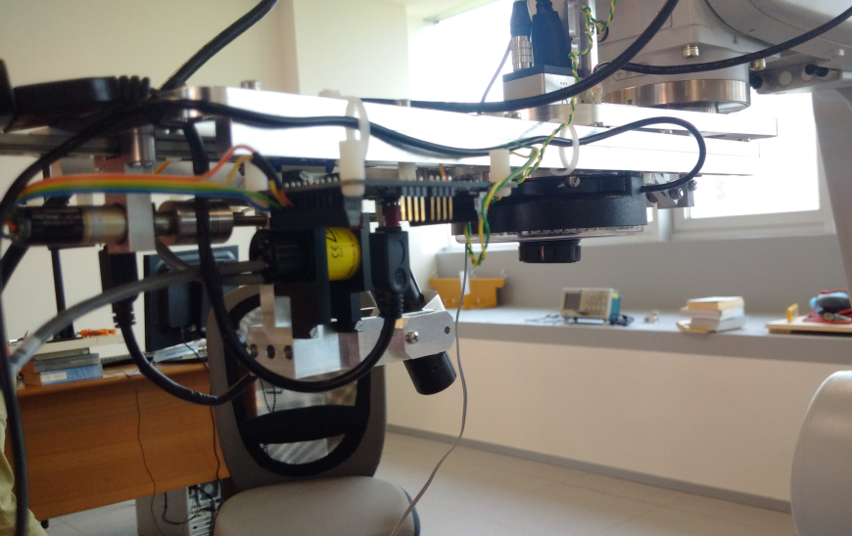
First release of LA-ROSES end-effector realization and assembly

Slide 15
“x-axis” motor resolution test
Method used:
  set-up of the motor parameters through Faulhaber proprietary interface
  motor displacement of 39 mm (proper caliber)
  error on motor 90° rotation calculation estimated in ±0,1 mm
  n. of step required: 2.000.000
Resolution obtained: 1,95E-02 μm (±5,00E-05)

Slide 16
“α angle” measured relative resolution
Laser working distance:
  100 mm (min)
  150 (max)
Method used:
  set-up of the motor parameters through proprietary (Faulhaber) interface
  motor rotation of 90° (bubble level)
  error on motor 90° rotation estimated in ±2°
  n. of step required: 206.500
Results:
  average displacement “l” at 100 mm working distance: 7,61 E-01 μm (±1,69E-2 μm)
  average displacement “l” at 150 mm working distance: 1,14 mm (±2,54E-2 μm)
l
α
L=100; 150 mm

Slide 17
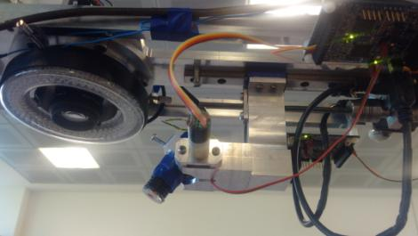
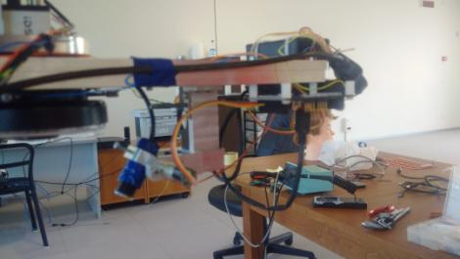
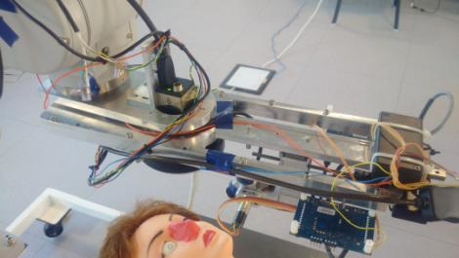

Present configuration
Vertical revolution greater than 360 degree around NIR camera optical axis
Video Link Channel
https://youtu.be/iNf7rvW5Rx8

Slide 18
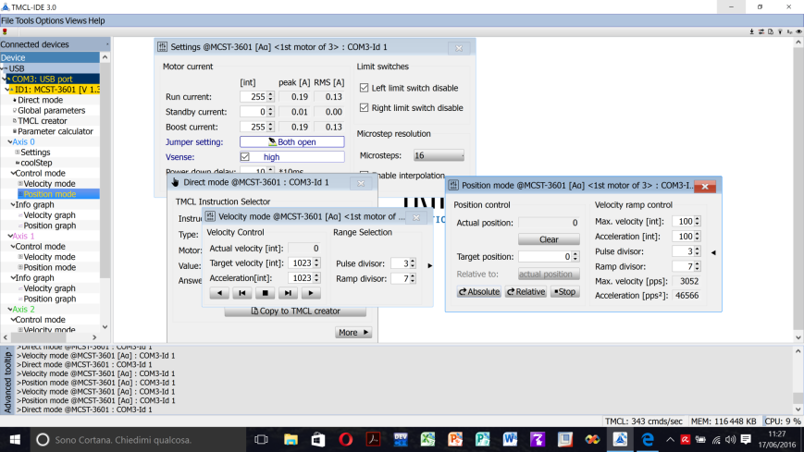
Faulhaber IDE for setting motor’s motion parameters for laser movement

Slide 19
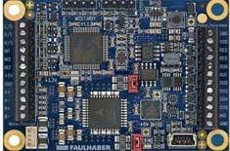
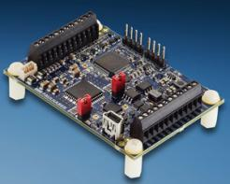
Motor driver control Unit
To simplify the motor control all selected motors are driven by the same type of control unit: the Faulhaber the MCST 3601 .

Slide 20
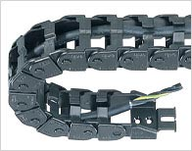
Further activities on end-effector
“z axis motor” repair
electronics and cabling “strategy” for rotating board
“x axis”
motor board
“x axis”
switch
“α axis”
motor board
“α axis”
switch
Ring light
USB
Laser

Slide 21
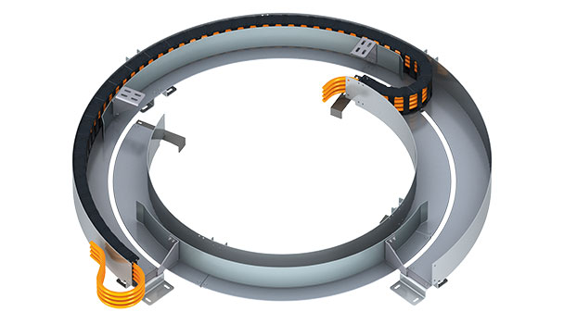
Chain solution for rotational movements

Slide 22
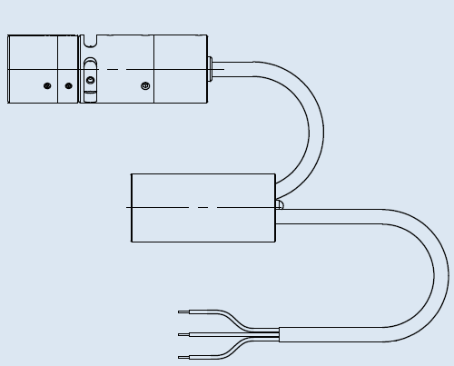
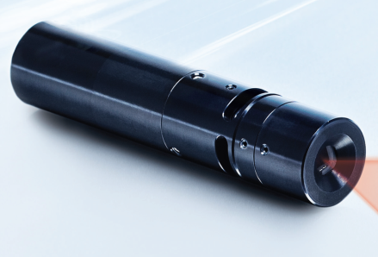
Osela Streamline Laser
Laser
19 mm
56,1 mm
power/driver unit
Customized 1000 mW

Slide 23
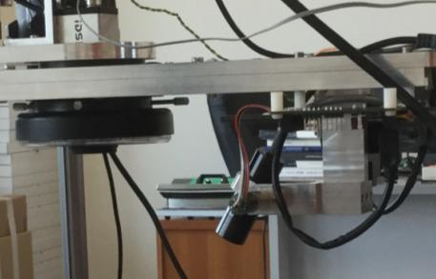
Osela laser characteristics
compact dimensions and low weight
required wavelength (810 nm)
linear power control (0-1 W)
continue wave (cw) and pulse train emission modality
control of the spot dimension around 40 μm and depth of focus < 10 mm
The compact diode laser

Slide 24
Laser control unit functional diagram
USB 3.1
RS232
Sync signal
Power Supply 5V@1A DC
Microcontroller PIC 16C721
NIR
camera
SPI
PWM
Intensity control signal
Laser
DAC MAX 504

Slide 25
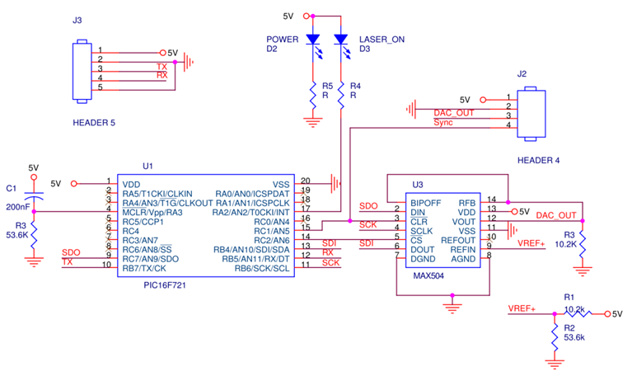
Laser control unit schematic diagram

Slide 26
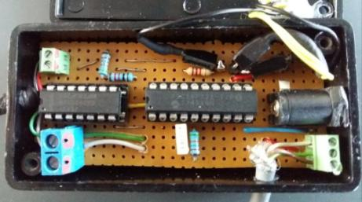
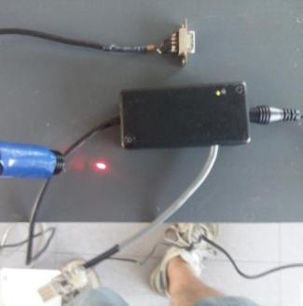
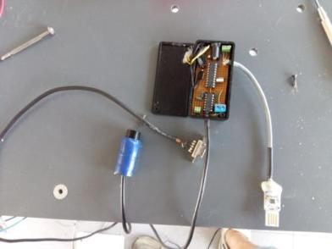
Laser control unit prototype realization
Microcontroller PIC 16C721
DAC MAX 504

Slide 27
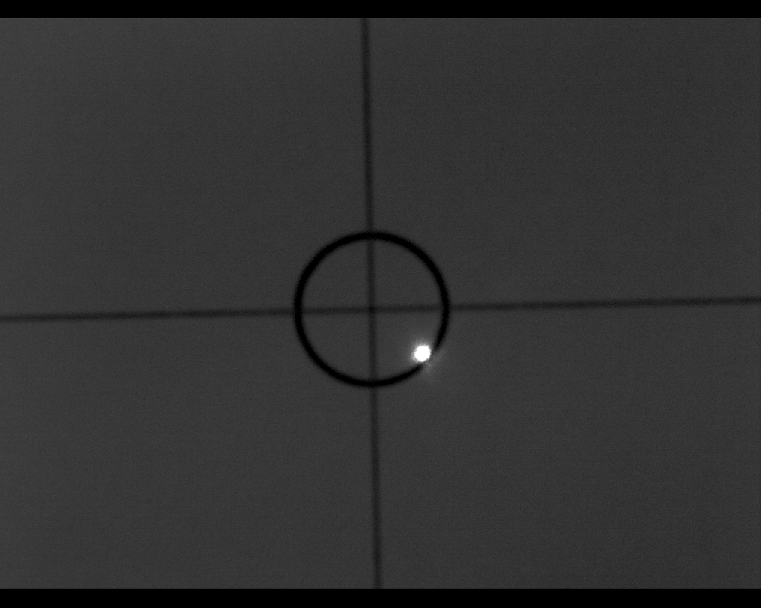
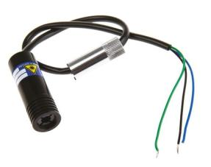
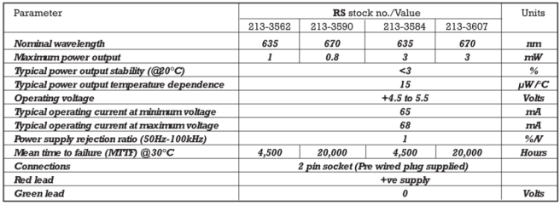
Laser movement control system development
For a safe development of the entire system a low cost and low power (1 mW) laser is used:
  visible wavelength at 690 Nm
  acquirable by NIR camera
  low power emission (1 mW)

Slide 28
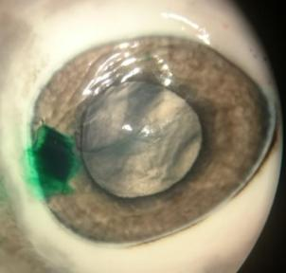
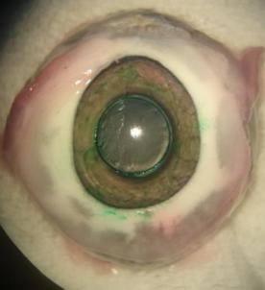
Osela Laser tests: welding effect
Ex vivo tests in porcine eyes
Different cut shapes
Surgical cut (parallel to lamellar planes- simulating lamellar keratoplasty)
ICG staining
Surgical cut (half depth- simulating PK)
ICG staining

Slide 29
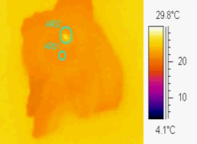
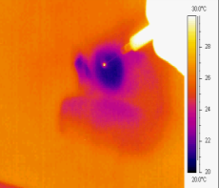
Comparison with old tests (manual laser, fixed target)
New «robotic» laser (moving)
Old manual laser(static)

Slide 30
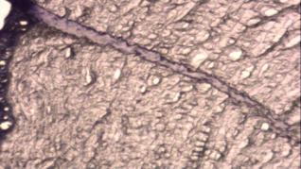
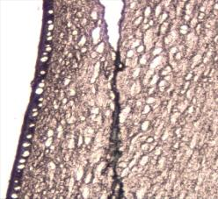
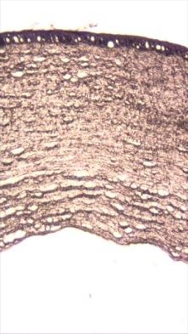
Laser source tests: H&E evidence of welding effect
Welded stroma
Surgical cut walls (PK)
Surgical cut (ALK)
Healthy cornea
Welded stroma

Slide 31
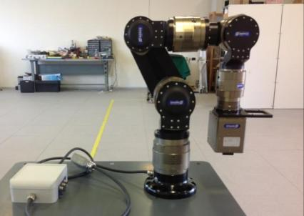
SCHUNK Light Weight Arm
The selected arm was the SCHUNK Light Weight Arm (LWA3):
6 Degree Of Freedom (DOF) having 6 rotational joints
controlled via a computer with a CAN bus interface operating at 500kbits/s.

Slide 32
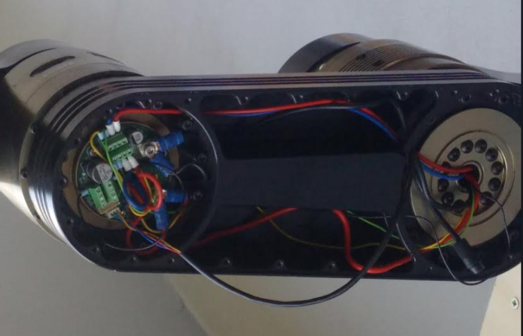
SCHUNK robot broken joint

Slide 33
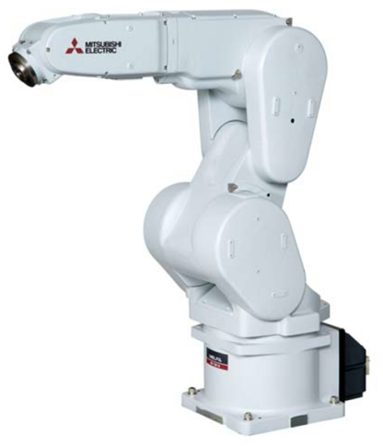
The new robot: Mitsubishi RV-13FM
Main features
6-axis
Repeatability: ±0,05 mm
Payload: 13 kg
Linear Workspace: 1094 mm
Weight: 120 kg
real-time path control capability

Slide 34
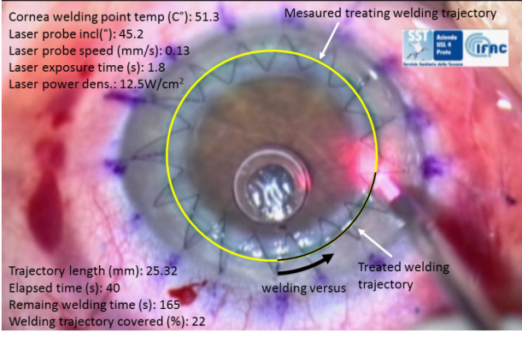
  The control system
The robotic platform will provide a graphical user interface (GUI) allowing the surgeon to operate from a remote console. The surgery procedure will start enabling the control system of the robotic arm to adjust the position and the orientation of the suturing end-effector just above the patient’s eye.
The laser module will be autonomously positioned by the robotic arm by using a Visual Servoing (VS) control scheme

Slide 35
LA-ROSES robotic platform control strategy definition
Welding trajectory detection
The control system will detect and calculate the welding trajectory; then all the system parameters related to the welding process will be proposed to the surgeon check, before enabling the start command.
Surgeon direct control
However, the corneal welding task will not be fully autonomously executed by the robotic platform control system: the surgeon will have a direct control of the surgical procedure.
“Collaborative” human-robot control paradigm
  Surgeon robotic welding-task supervision: robot executes the welding task while the surgeon controls and adjusts (if needed) robot movements and laser parameters
  Surgeon and robot can immediately stop the running welding-task. Human expert like a surgeon is, is more capable to handle unexpected scenarios, as opposed to an autonomous robot; at the same time, the robot control system could autonomously decide to stop the task in case of coming out about dangerous situations to preserve patients’ health.

Slide 36
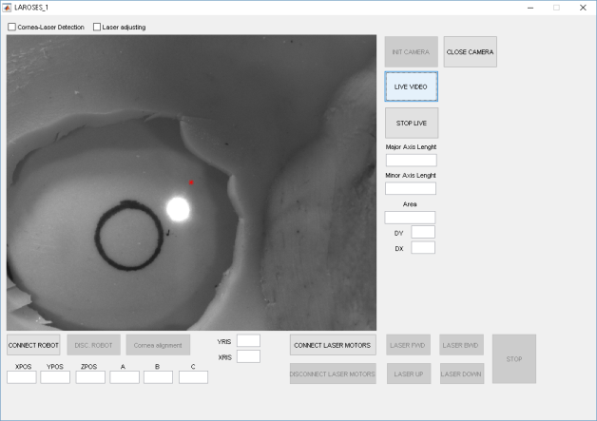
Preliminary LA-ROSES visual servoing control scheme implementation
Cornea detection and alignment
Image center
i.e. camera optical axis
Corneal wound

Slide 37
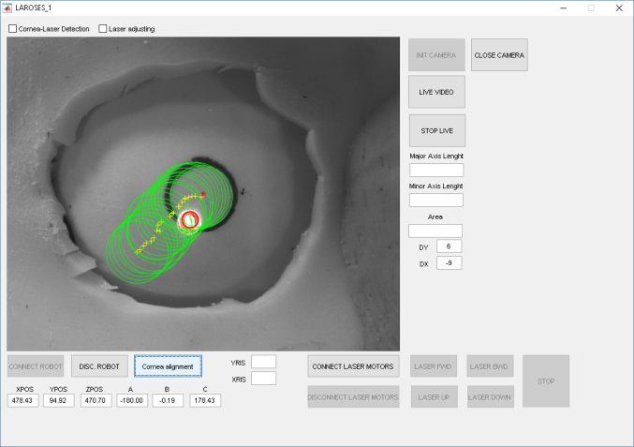

Preliminary LA-ROSES visual servoing control scheme implementation
«Cornea» path

Slide 38
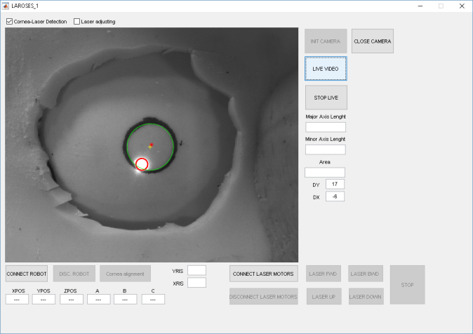
Preliminary LA-ROSES visual servoing control scheme implementation
Cornea and laser spot
detection

Slide 39
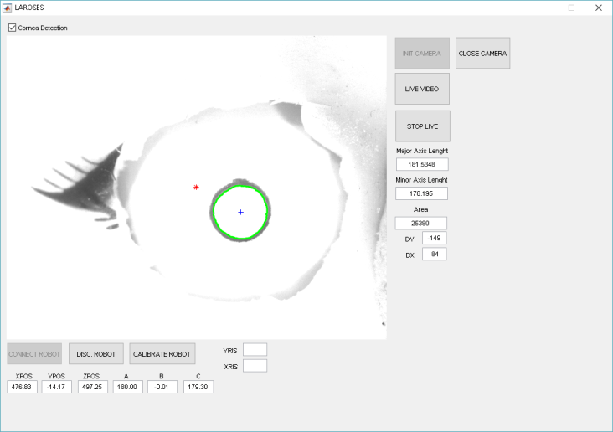
Preliminary LA-ROSES visual servoing control scheme implementation
Corneal wound
Camera/image center
«Eye»
current parameters
Distance between Eye and Camera Center
Eye center
End-effector Cartesian world frame position

Slide 40
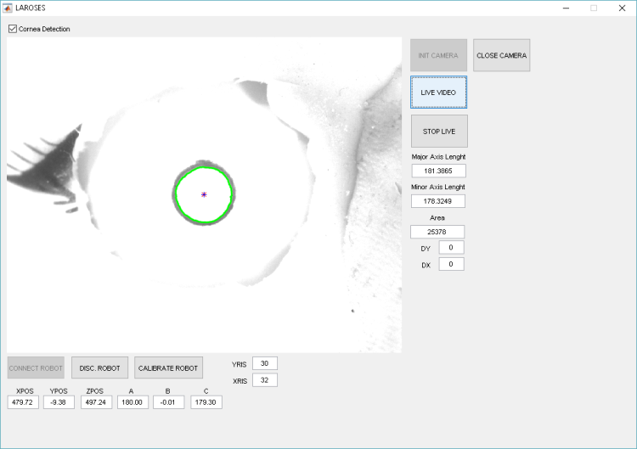
Camera calibration and eye-image centring
robot precision allows ZERO camera resolution error
Camera/robot calibration parameter.
NOTE. A NEW camera/robot calibration is required once a different working height is detected. Major/Minor axis length and eye area provide out a measure of the current working height. Thus the implemented VS scheme using these parameters autonomously calibrate and move according the robot to keep in time the eye centre aligned with the camera optical axis.

Slide 41
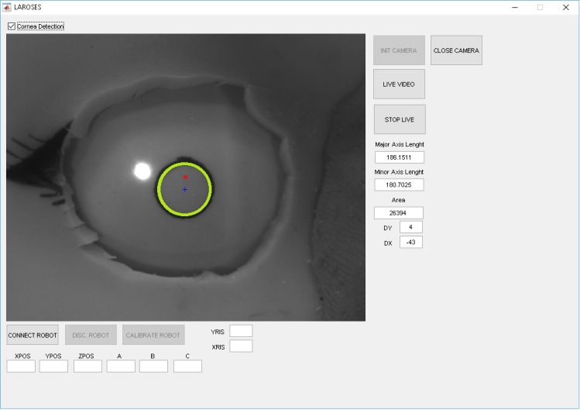
Laser detection

Slide 42
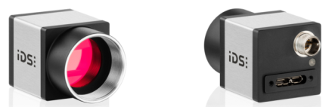
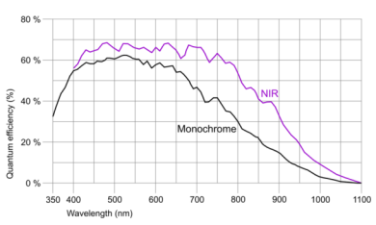
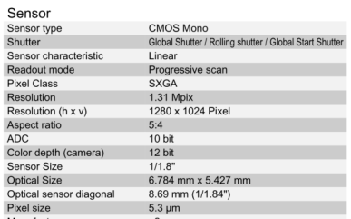

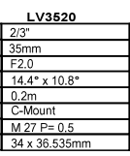
IDS camera UI-3240CP-NIR-GL Rev.2
At WD of about 200mm we have an optical/camera resolution of 40 um/pix

Slide 43
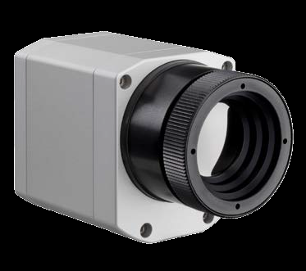
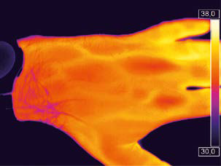
Thermal Camera
Dimensions: 46 x 56 x 90 mm
thermal sensitivity: 40 mK
thermal image recording in real time at up to 80 Hz
weight: 320 g incl. lens
detector with 382 x 288 pixels
usable at ambient temperatures of up to 70 °C without the need for additional cooling
optris® PI 450
INFRARED CAMERA

