Slide 1
European Clearing House for Open Robotics Development Plus Plus
Reporting Procedure and Financial Issues
Marie-Luise Neitz
TUM
Experiment Kick-Off January 15th, 2015

Slide 2
Overview
Amendment Process
Options for Experiment Start
Contracts to be signed
Funding Components
Budget Management Tool
Reporting Periods
Periodic Reports
Cost Claims

Slide 3
Administrative Procedure
Amendment Process
✓
Update of the DOW
(Publishable Summary & WP tables)
✓
NEF System
Enter administrative data and budget (validation!)
Questions
Suspension
Resubmission
Submission in NEF System
Verification loop with the EC

Slide 4
Administrative Procedure
Amendment Process
✓
Update of the DOW
(Publishable Summary & WP tables)
✓
NEF System
Enter administrative data and budget (validation!)
Questions
Suspension
Resubmission
Problem: Validation not properly mirrored in NEF
Change of Indirect Cost Model: Fabrica 136, CDD M.E.P.E.
No change of Indirect Cost Model possible: Idelt (no SME)
Submission in NEF System
Verification loop with the EC

Slide 5
Administrative Procedure
Amendment Process
Legal Validation
Indirect Cost Model
Partner Information Form
Legal address, person with right to sign the Grant Agreement, Administrative Representative, Scientific Representative, LEAR, PIC.
PIC Validation
Legal Entity form and VAT document, SMEs Checklist

Slide 6
Delay → 2 date options to join the project
CoHRoS
DexBuddy
LA-ROSES
LINArm++
MODUL
MOTORE++
Pickit
ROAR
SAPARO
2F
3DSSC
DEBUR
EXOTrainer
GARotics
MARS
Tirebot
Implications!

Slide 7
Administrative Procedure
Contracts to be signed
Grant Agreement
via Amendment
Consortium Agreement
Mandatory to join the project
Optional between the partners for the experiment Template provided by E++
Form Bs

Slide 8
Financial Issues
Funding components
Activity Type (RTD)
Cost categories
EU contribution
Budget
Cost capping!
→ €€€
Subcontracting!
Pre-Financing
Guarantee fund
→ €€€
Cost Claims
6 monthly financial reporting?
Guarantee fund
€€€
TBD!

Slide 9
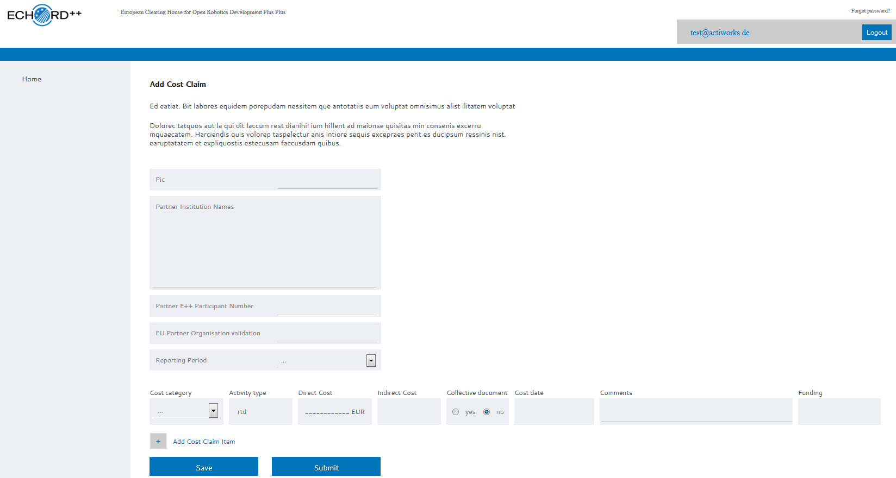
Financial Issues
Budget Management Tool on the ECHORD++ Online Portal
Connected to Monitoring Tool!

Slide 10
Reporting
Reporting Periods
Jan 1, 2015
July 1, 2015
Nov 1, 2016
Nov 1, 2017
€
€
May 1, 2015
€
€
€
incl. Kick-Off

Slide 11
Reporting
Reporting Periods
Jan 1, 2015
July 1, 2015
Nov 1, 2016
Nov 1, 2017
€
€
May 1, 2015
€
€
€
incl. Kick-Off
Sep. ‘15
Dec. ‘16
Dec. ‘17
Perdiodic Reports: due 60 days after end of reporting period

Slide 12
Reporting
Periodic Report
Publishable Summary
Activities in the reporting period
Deviations
Major cost items (10% deviations on average active PM for need explanation)
Template for calculation of active PM provided by E++

Slide 13
Cost Claim
Costs entered on E++ platform
(to be on the safe side)
Also input for monitoring platform (budget overview, budget used)
Costs entered in NEF
→ “Use of resources”

Slide 14
1
2
3
4

