Slide 1

European Clearing House for Open Robotics Development Plus Plus
Monitoring procedures and platform
Reinhard Lafrenz
TUM
Experiment Kick-Off
Paris, January 15th, 2015

Slide 2

What is the monitoring for?
To ensure that all experiments are on track
To identify potential problems and their causes
To support the experiments in case of problems, delays, etc.
To guide the experiments towards
impact creation
To have a global overview of the
status of all experiments
To prepare the formal periodic reports

Slide 3
Roles in the monitoring process
Experimenters:
Provide information about the progress of the experiments
Ideally more multi-media based (videos, photos, simulations, …) than text
Discuss the state with their moderator
Moderators:
Assignment of two moderators individually to each experiment
Familiarity with the application field and/or the methods/technology
At least one of them also familiar with the administrative issues and procedures to support the experiment

Slide 4
Monitoring Procedure:
Monitoring periods: after every two months
Month 2
Month 4
Month 6
…
Components of the monitoring
Images, Videos, Simulations, etc.
Self-
assessment
Blog
discussion
Traffic
Lights
Problems, delays, any other info
Report
Short (!)
explanatory
text
Moderator assessment
Support by moderator

Slide 5
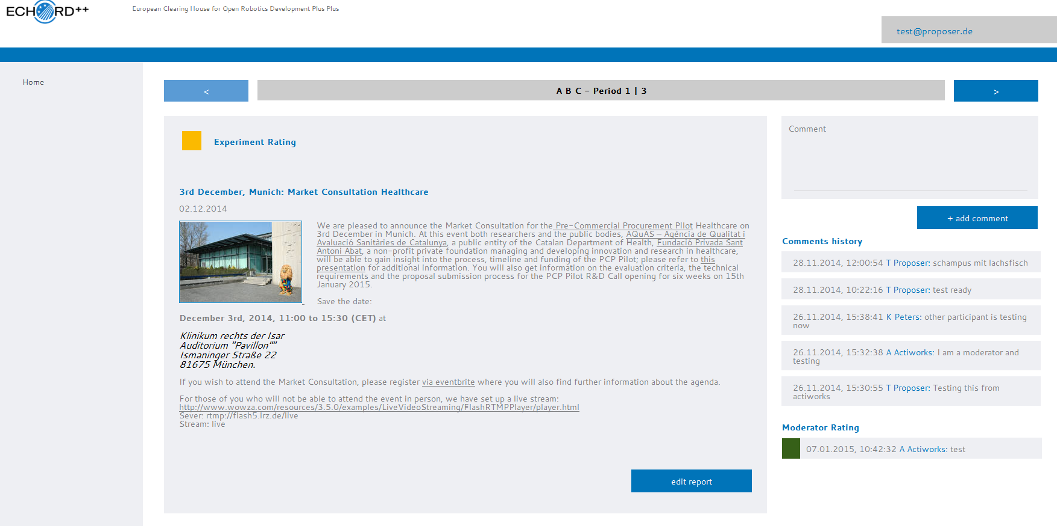
Writing the reports (1)
Experiment’s self-assessment
Add comment
Edit
Moderator’s assessment

Slide 6
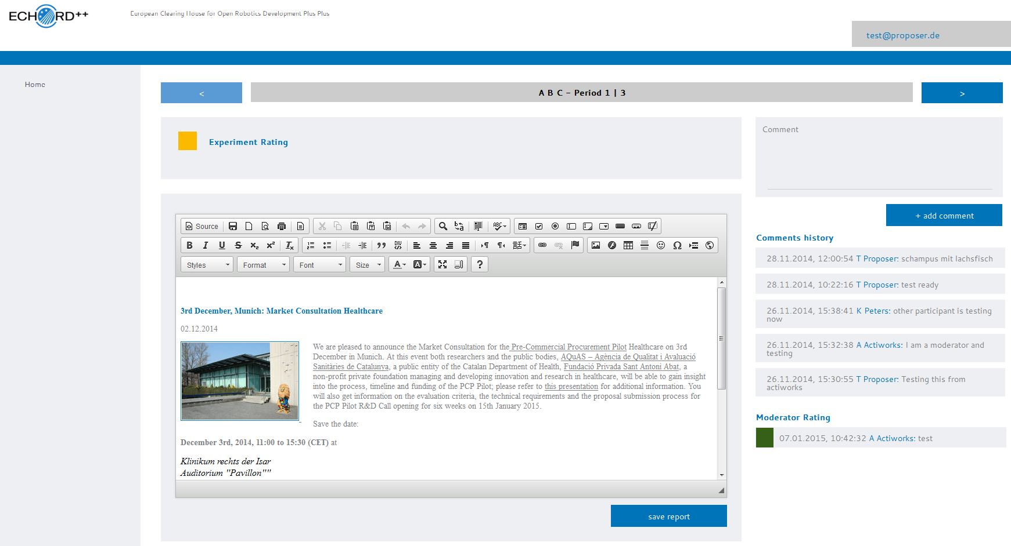
Writing the reports (2)

Slide 7
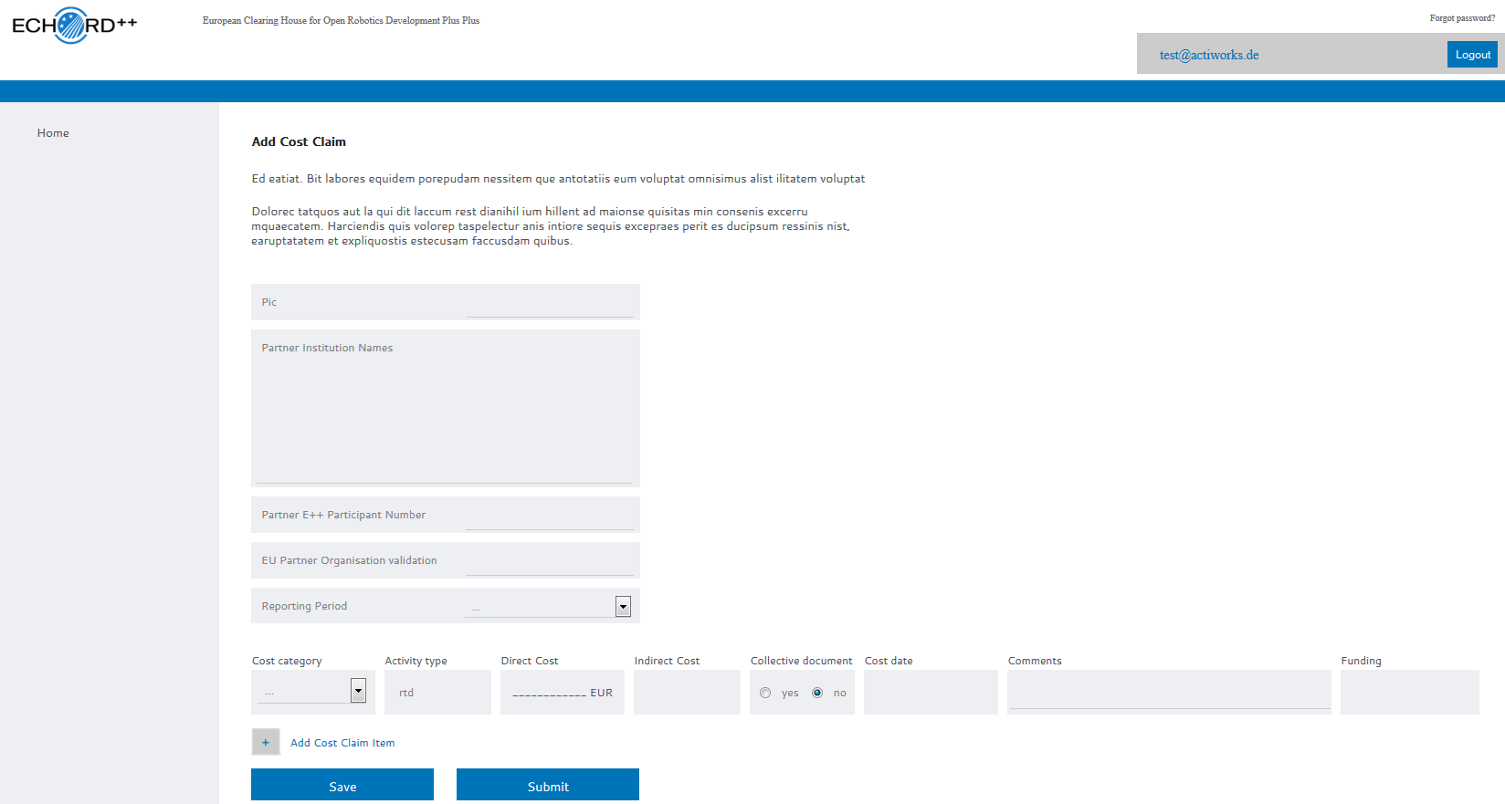
Financial Issues
Budget Management Tool on the ECHORD++ Online Portal
Connected to Financial Tool!

Slide 8
Moderator assignment for the experiments

Slide 9








Thank you.
Questions?
The ECHORD Plus Plus Consortium acknowledges support by the European Commission under FP7 contract 601116.

